Slide 1
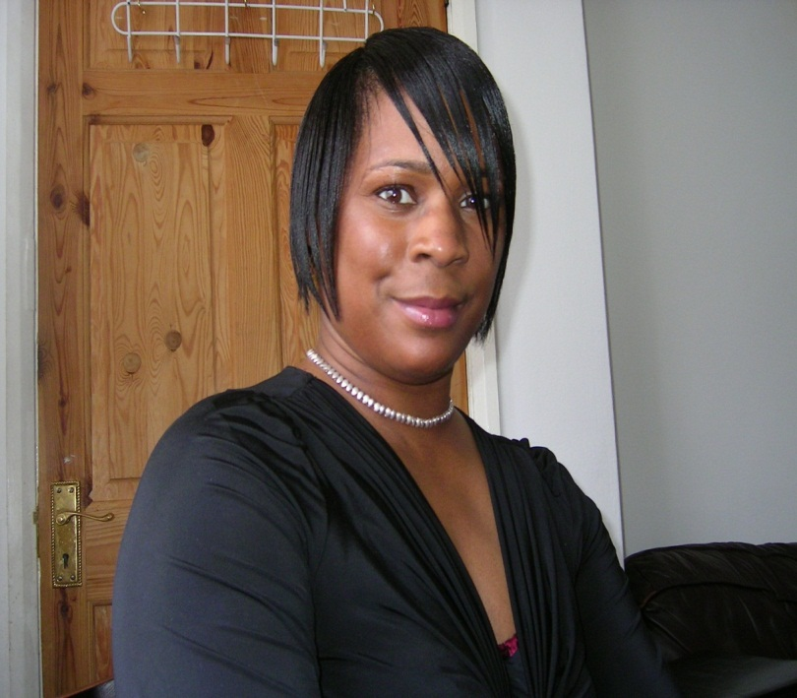
Maureen Bailey Head of Inner Strength Network
Inner strength is something instilled in you. It is a determination to overcome over all the obstacles that you face in life. It is the difference between excellence and failure. It is the tool to help others be the best they can be.”

Slide 2
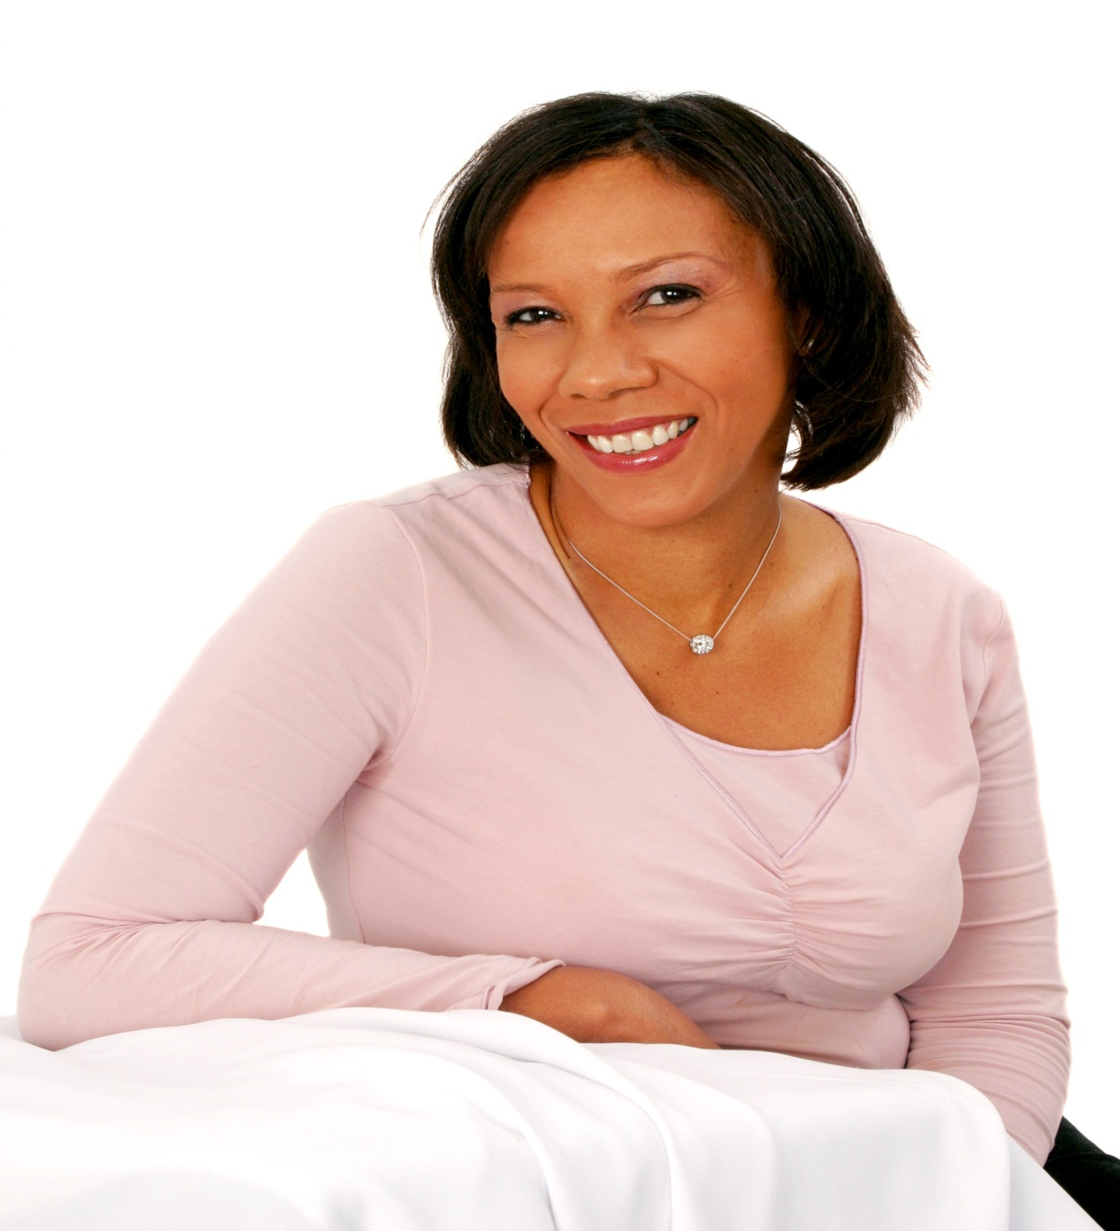
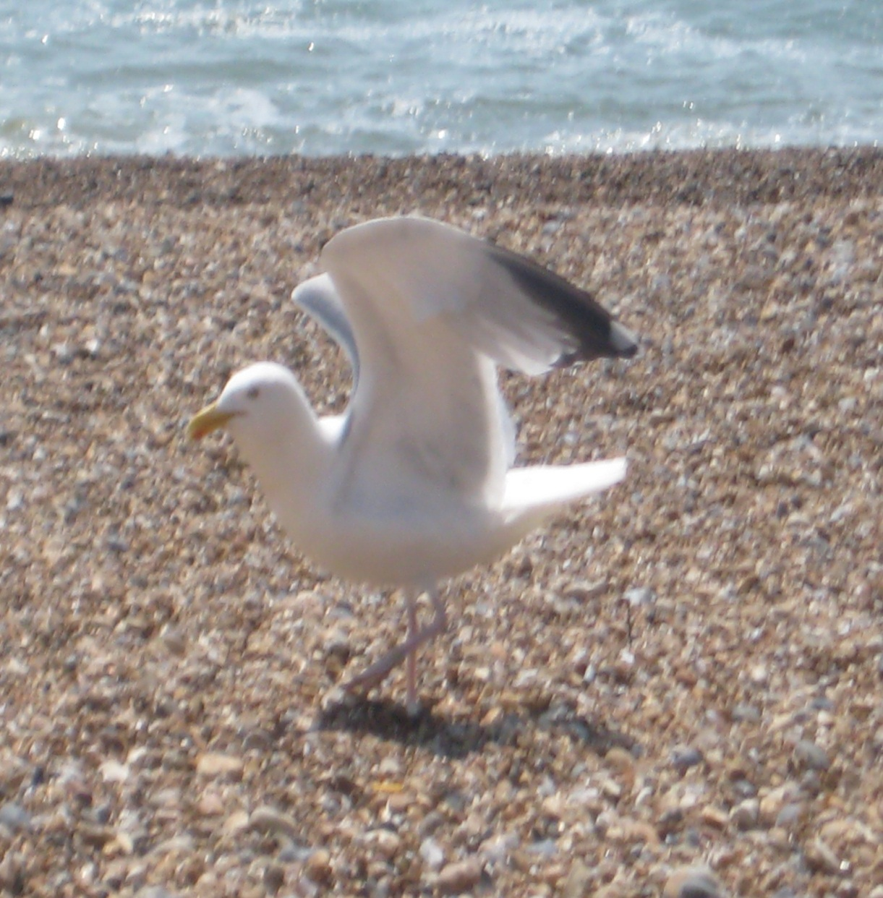
Audrey Linton Business Woman
“I believe it has to be my faith in God - not so much how faithfully I am to him, but how faithful he is to me! Because at times I don't think I have inner strength, but it’s when those testing situations come, that you realise there is a lot more in you than what meets the eye -

Slide 3
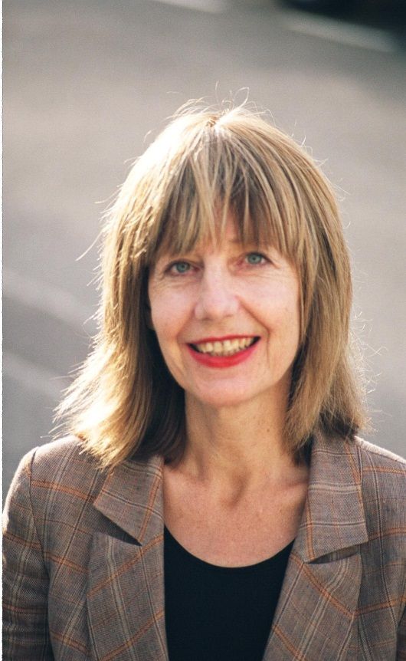
Carole Stone
Author and Broadcaster
Winner of Britain’s Best Connected Woman’
“My inner strength comes from believing that we grow stronger by the way in which we deal with what life throws at us”

Slide 4
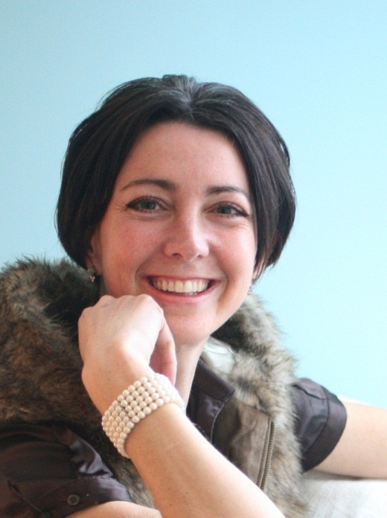
Maggie Ellis
Director of Life Centre Rape Crisis Service and a psychosexual therapist
“Inner strength has come from my Christian faith....knowing God is with me and is so much bigger than what I can manufacture, being able to pray for and experience His protection and finding peace and inner cleansing when I need it. When God is there, there is always a better space to fall back into when life is tough.”

Slide 5
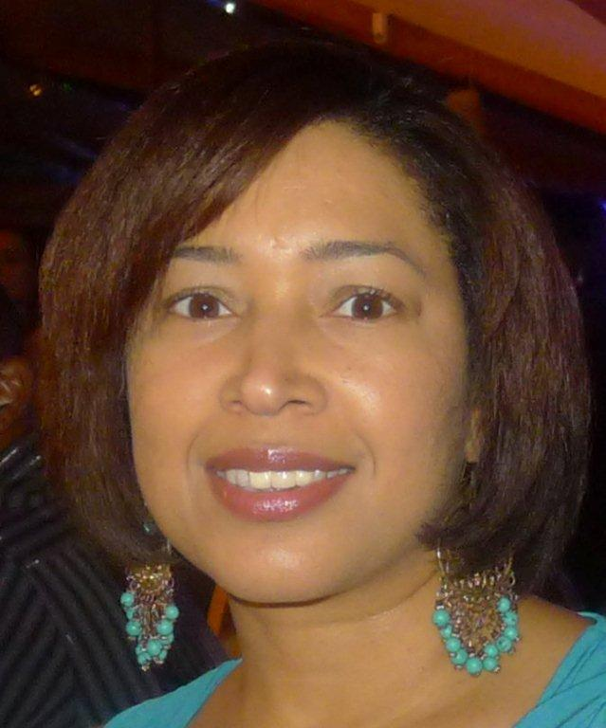
Juliana Bardoullie
The 1st Black Financial Ombudsman
“Deep breathing and meditation; when life gets hectic, the automatic reaction is to speed up with it. But then we get out of breath; we can’t do things when you can’t breathe. So stopping for a moment taking a few deep breaths and ask God for inner strength. Also remembering the serenity prayer. What do I really have control of – do something about it. Everything else is someone else’s business – let them get on with it.”

Slide 6
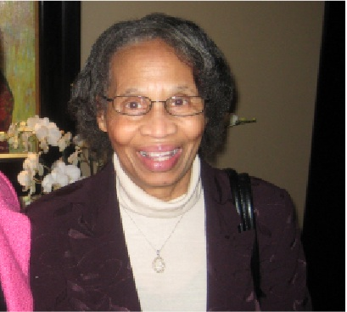
Lucy Sylvester
78 years Activist on Pension Rights
“If I did not have Inner strength I would not be alive. You need the belief to be strong. You need to look forward for the better instead of the worse. You need to thank God for the day and ask him to keep you. I am always grateful for my life. Many don’t live to see my age. I am still here -It makes me stronger every day. Remember if you are aiming for something in life you need to believe it will happen.”

Slide 7
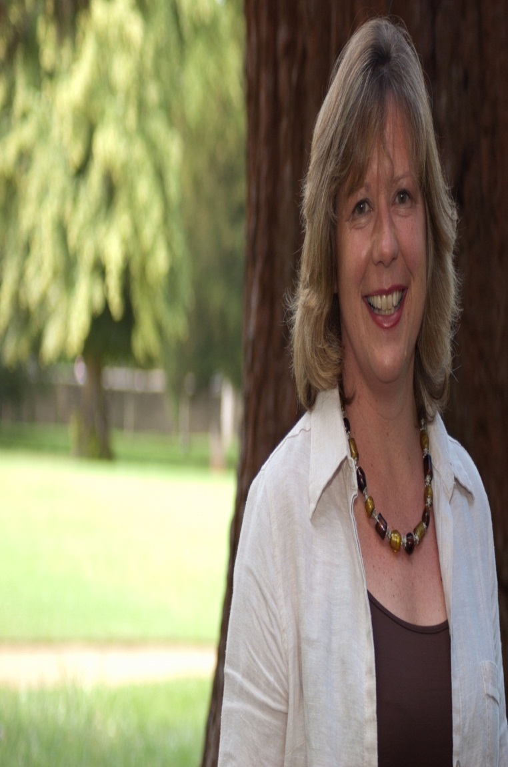
Sue Stockdale
The First British Woman to ski to the Magnetic North Pole
“What gives me inner strength is my belief that life and work is an adventure; and you will never know what you can achieve unless you are prepared to take a step into the unknown. Sometimes that will be difficult and at other times easy, but it is always an opportunity for learning.”

Slide 8
Silvia Petretti
Silvia is diagnosed with HIV and fights to improve the rights of women
The sense of interconnectedness with other beings and nature gives me inner strength. I feel that my being and my actions are interwoven in the lives of others and of our planet. When I feel I cannot do something I always think I am not doing this by myself or for myself. I continue in the actions of those who before me tried to contribute a positive change, and I think of those who after me will continue to strive for a better and just world for all. I am a small part of something much bigger. I take a deep breath, feel the ground under my feet, I look at a garden, play with my cat… and keep going.

Slide 9
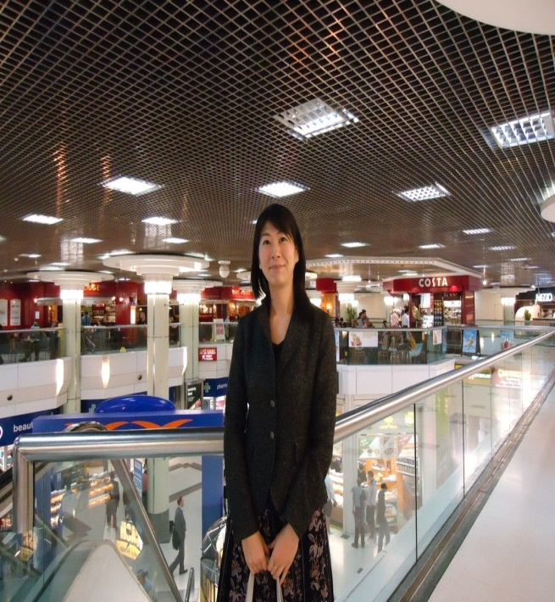
Shoko
Japanese Civil Service
“In my view, good peers and mentors.
With them supporting me and encouraging me, it always gives me confidence and power to keep trying”

Slide 10
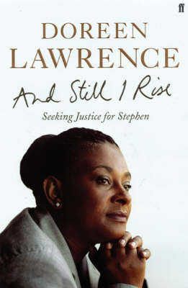
“For me inner strength can only ever be described as unwavering Faith that gives you the courage to fight but you must first find the courage to believe”
At the Inner Strength Conference March 2012

